Slide 1
Deep Learning in Autonomous Driving
Direct Perception Approach
Timo Bergerbusch
Seminar
am Lehrstuhl für Software Engineering
RWTH Aachen

Slide 2
(Convolution) Neural Nets
neural net: 3 layer-types
convolutional:
multiple Hidden-Layer (deep)
different layers:
fully-connected
not fully-connected
…
Input
hidden
output
Notes:
Neural nets:
Simple principle: neurons with weighted sum – bias
Organized in layers
Training = adjusting the weights and biases
Conv. NN:
More than 1 hidden layer
Different layer types:
Fully-connected
Convolution: feature detection considering scale, rotate (shared weights -> more efficient)
Pooling: reduction of input
ReLU: mathmatical normalization
AlexNet: used in the approaches given

Slide 3

(Convolution) Neural Nets
neural net: 3 layer-types
convolutional:
multiple Hidden-Layer (deep)
different layers:
fully-connected
not fully-connected
convolution
-1*7 = -7
2*6 = 12
2*6 = 12
0*9 = 0
7
6
5
5
17
22
7
6
9
1
3
-1
2
20
-5
9
$Σ$ 17
4
1
2
8
2
0
2
21
20
2
9
3
1
Notes:
Convolution:
Based on biology: frontal cortex reacting to stimuli in special field
feature detection considering
Scale
Rotate
Position
Set of features -> set of filtered images
shared weights -> more efficient

Slide 4
(Convolution) Neural Nets
neural net: 3 layer-types
convolutional:
multiple Hidden-Layer (deep)
different layers:
fully-connected
not fully-connected
convolution
ReLu
17
22
7
17
22
7
20
-5
9
ReLu
20
0
9
2
21
20
2
21
20
Notes:
Rectified Linear Unit (ReLU):
mathmatical normalization

Slide 5
(Convolution) Neural Nets
neural net: 3 layer-types
convolutional:
multiple Hidden-Layer (deep)
different layers:
fully-connected
not fully-connected
convolution
ReLu
Pooling
17
22
7
22
9
20
0
9
max. pooling
21
20
2
21
20
Notes:
Neural nets:
Simple principle: neurons with weighted sum – bias
Organized in layers
Training = adjusting the weights and biases
Conv. NN:
More than 1 hidden layer
Different layer types:
Fully-connected
Convolution: feature detection considering scale, rotate (shared weights -> more efficient)
Pooling: reduction of input
ReLU: mathmatical normalization
AlexNet: used in the approaches given

Slide 6
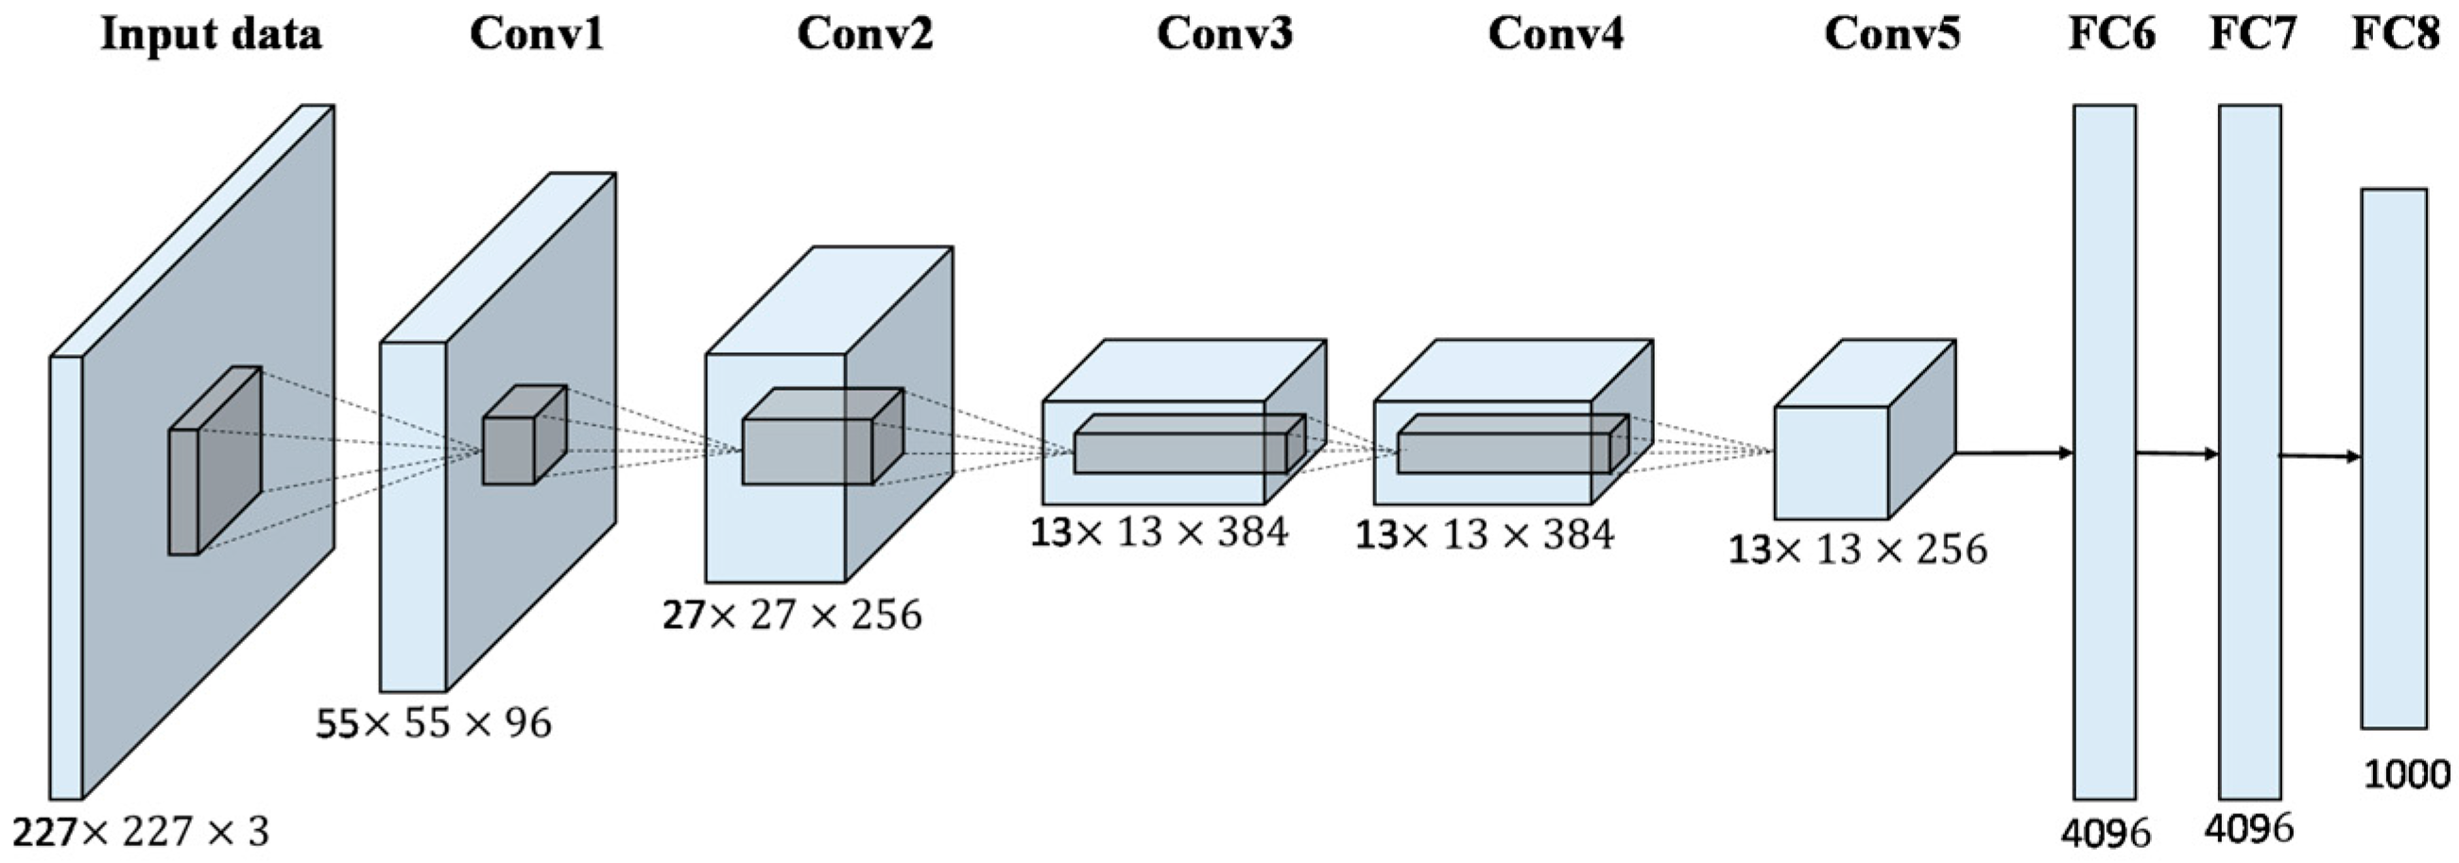
Important Structure
Alex-Net:
Notes:
Alex-Net:
Best performing 2012
Input -> 5 conv -> 3 fully-connected

Slide 7
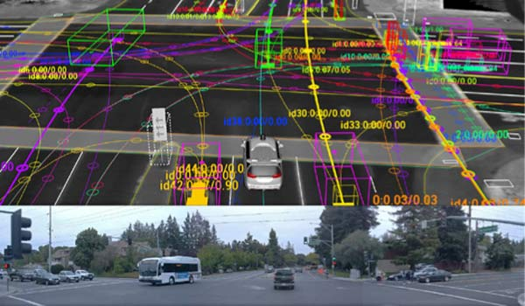
Current Approaches: mediated perception
multi-components
internal 3D-model
problems:
complex
irrelevant/redundant data
Components still research topics themselves
Possible individual components
Abrasion-detection
Pedestrian-detection
Distance-measures
Lane-detection
Vehicle-detection
Veloctiy-measures
Notes:
Mediated perception:
Mutli component complex system
Internal 3D model
Problems as given
=> Reasonable and sturdy approach but lacks flex. and efficiency

Slide 8
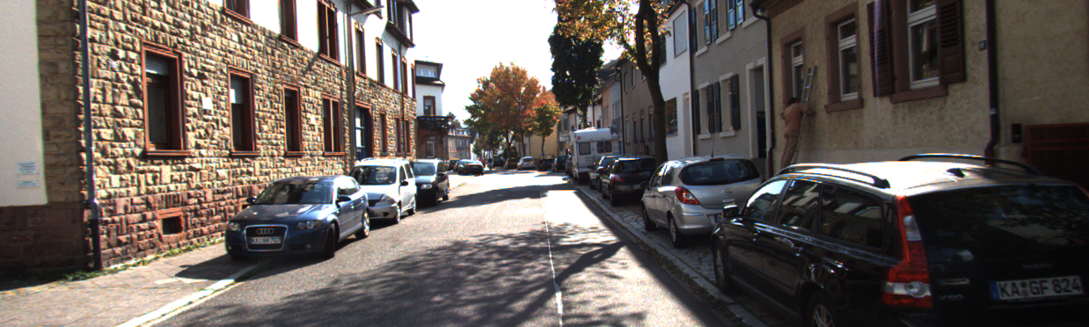
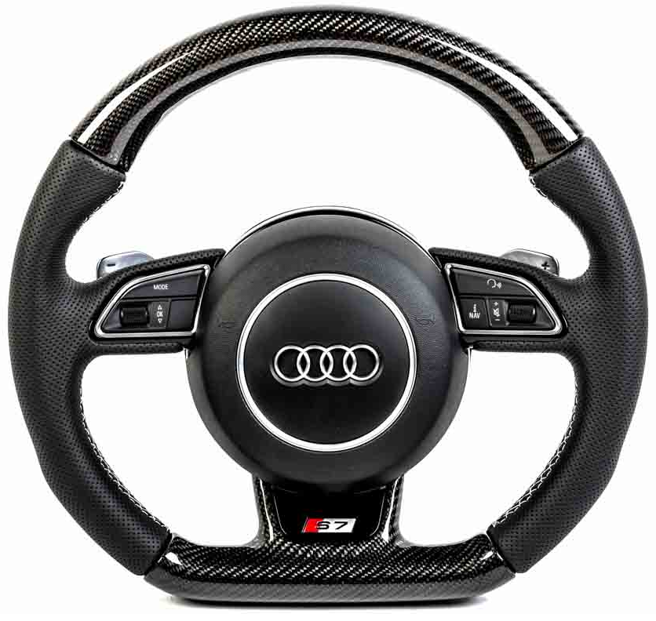
Current Approaches: Behavior Reflex
direct mapping of:
Image-input
steering angle
good for simple, bad very poor for complex tasks
Notes:
Behavior reflex:
Map input to angle

Slide 9
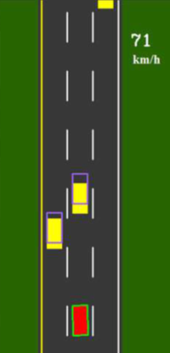
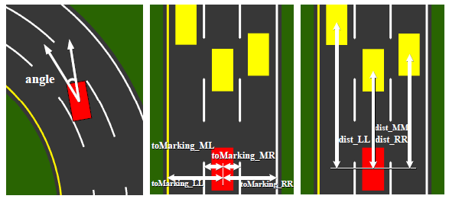
The Direct Perception
hybrid of: mediated und behavior
13 affordance-values
minimalistic modelling
Notes:
Direct Perception:
Hybrid
13 values: line distance, car distance, angle
2D
Distance guessing (also based on prev.)

Slide 10
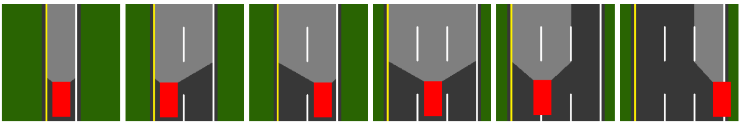
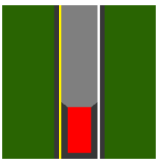
The Direct Perception
Highway driving scenarios
distinguish 2 situations:
Inactivity of currently irrelevant values
in lane
on marking
Example:
No cars on „right“ lane
No cars on “left” lane
But: distance to right lane
Notes:
Made for highway driving
2 situations
active/inactive
Controller

Slide 11
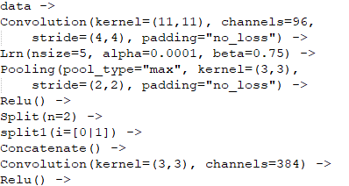
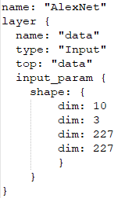
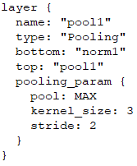
Deep Learning Languages
Different languages to model those CNNs:
CNNArchLang:
part of the MontiCore language family
uses the MxNet framework
Python like Syntax
Caffe:
specialized on modularity, speed and expressiveness
huge community
very verbose through Protocol Buffers
Notes:
CNNArchLang:
Till Timmermanns in his Master Thesis
Connector and Component
Not a framework itself
Caffe:
Long-established
Huge community
Google Protocol Buffers
One net: CNNArch 36 lines vs. Caffe 6700 lines

Slide 12
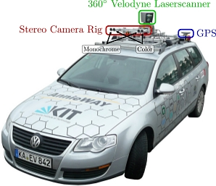
Training
Problem: very specific datasets
TORCS: The Open Racing Car Simulator
KITTI Dataset: 6 hours drive recording
different cameras and views
Additional measurements
Approach A:
stereo RGB camera
Approach B:
mono greyscale camera
distance laser sensor
Testset A
Testset B
Notes:
Problem of specific testsets
TORCS:
Get every value you want
Drawback: no noise, disturbance, Pedestrians, …
Kitti:
Many used options

Slide 13
Summary
Direct perception:
better than behavior reflex (based on TORCS)
as good as mediated perception (based on KITTI)
But: what about more complexity?
CNNArchLang:
simplistic language design (python-like)
elegant definitions of CNNs
through MxNet: SLI and Cluster usage
drawbacks:
no recurrent neural nets
missing set of pre-trained models
documentation
Notes:
Direct Perception:
proven handle highway
Complex tasks?
Signs
Pedestrians
Other faster cars
CNNArch:
Well suited
Highly efficient and scalable (MxNet)
Few minor problems (ok since new)

Slide 14
Demo
Small Image Classification

Slide 15
Video

Slide 16
Fin.
Thank your for your attention

